Slide 1



CEPS Engineering Organization
Come to fkn SpaceVision!
University of New Hampshire
Students for the Exploration and Development of Space

Slide 2

https://spacevision.seds.org/2019/
Leave early Thursday morning, 11/7 (on Calendar)
Return early Monday morning 11/11
Last year, we all paid out of pocket (~$800 per)
This year, I am confident that the only expense will be the flight ticket
~$425.00
UNH SEDS will have a bigger presence!
Journey to Spaceport fair presentation
Thomas, Lucas, Silas, Zach
Quadcopter research
Andrew
MIFP Presentation
Charlie
Media coverage of entire event
Kevin
University of New Hampshire
Students for the Exploration and Development of Space

Slide 3
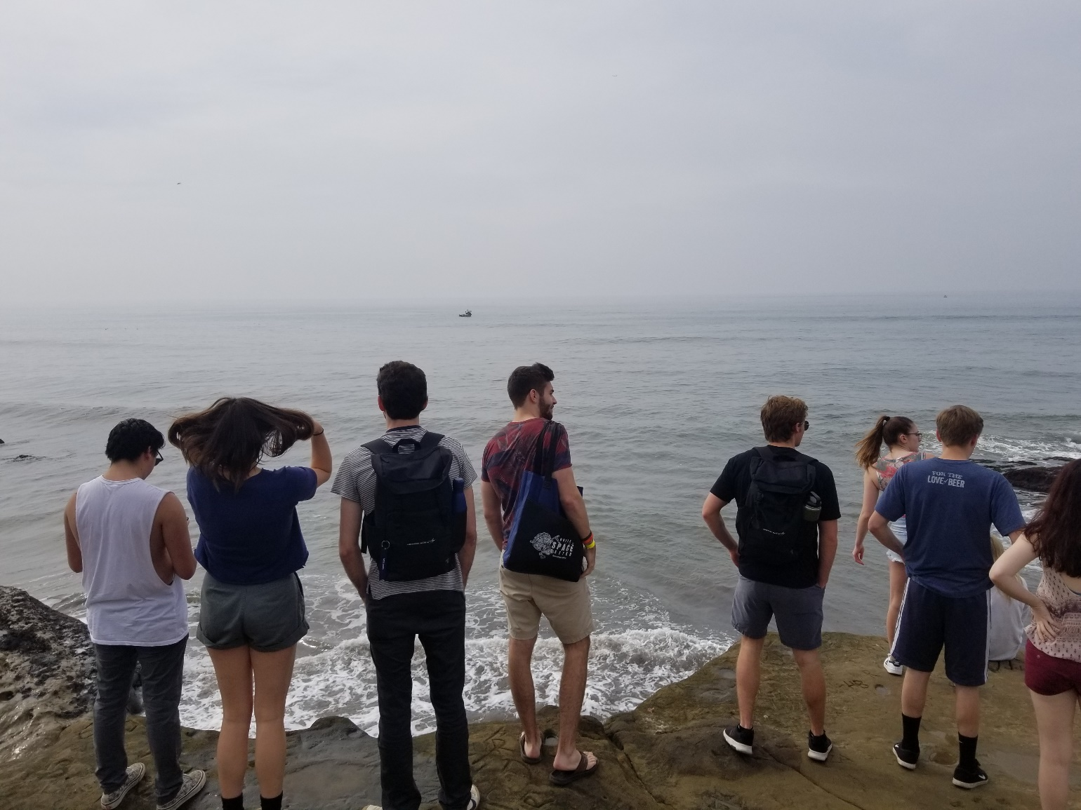
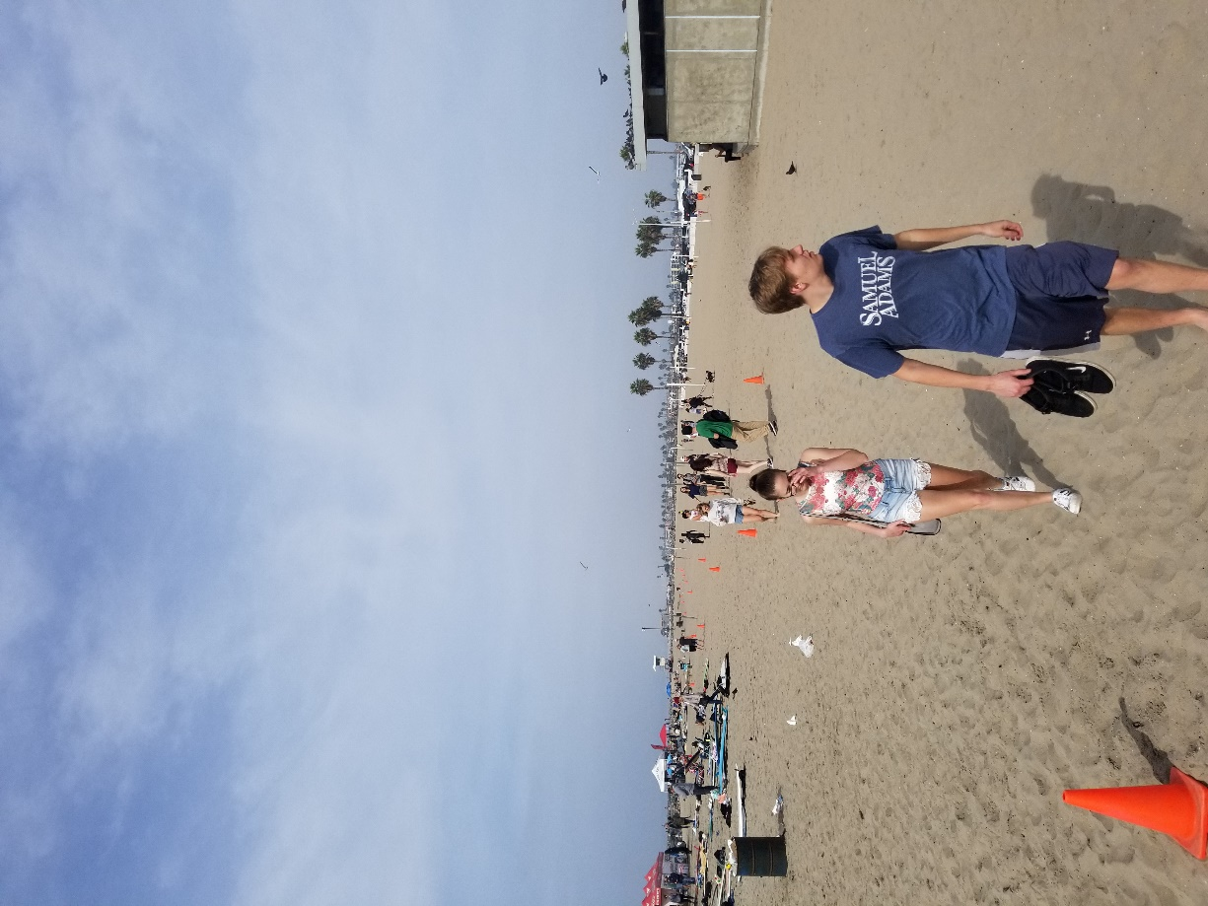
University of New Hampshire
Students for the Exploration and Development of Space

Slide 4
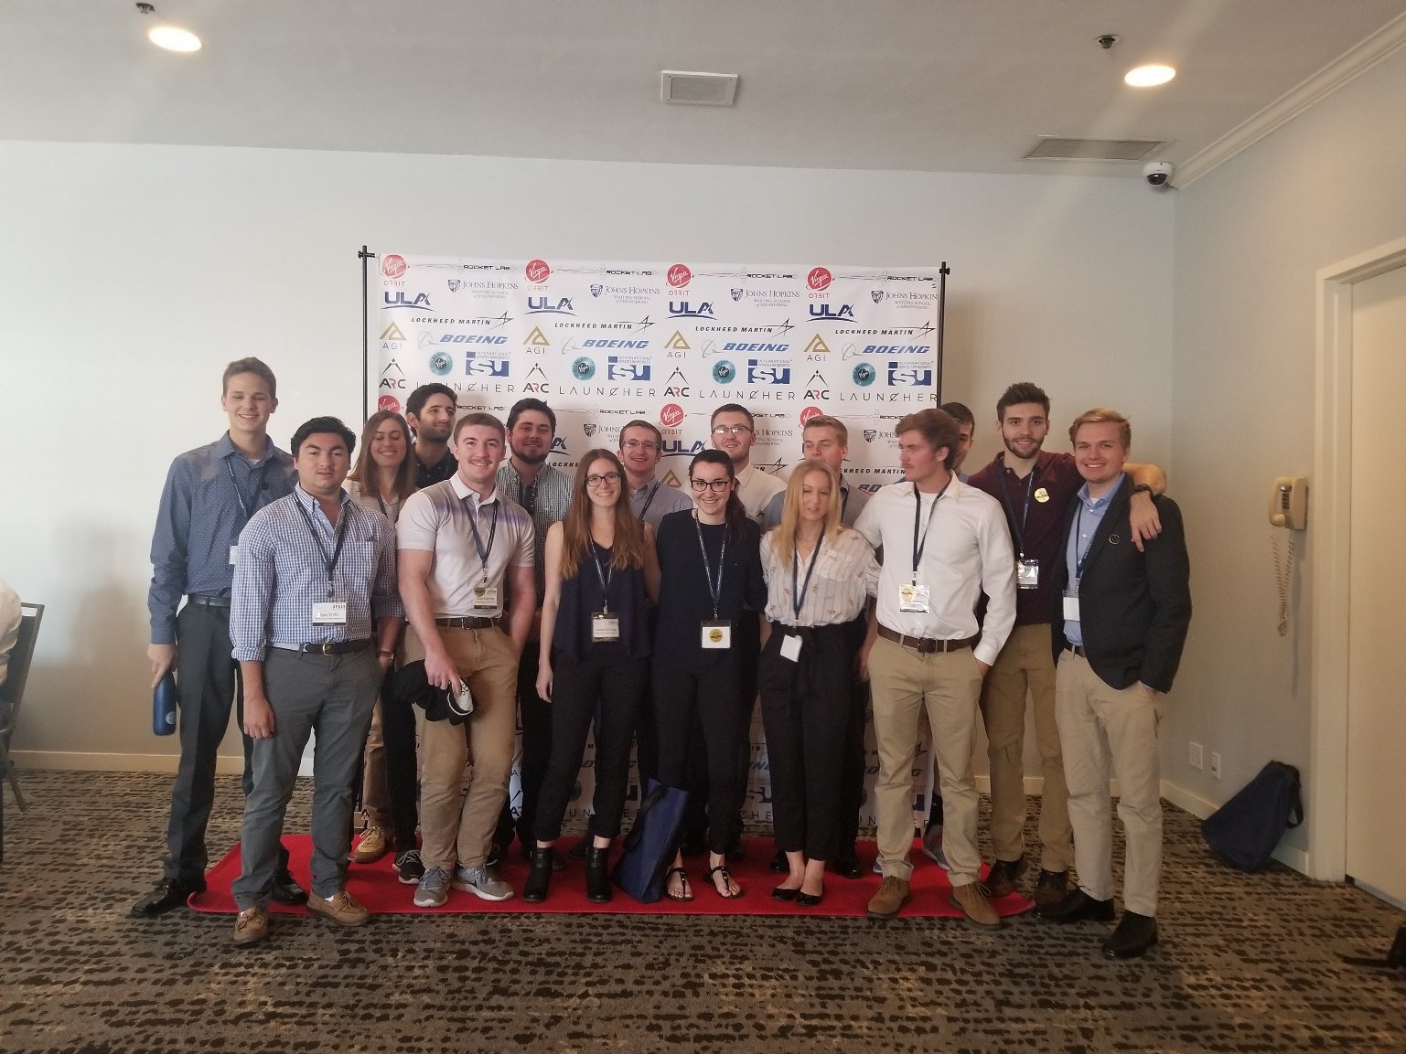
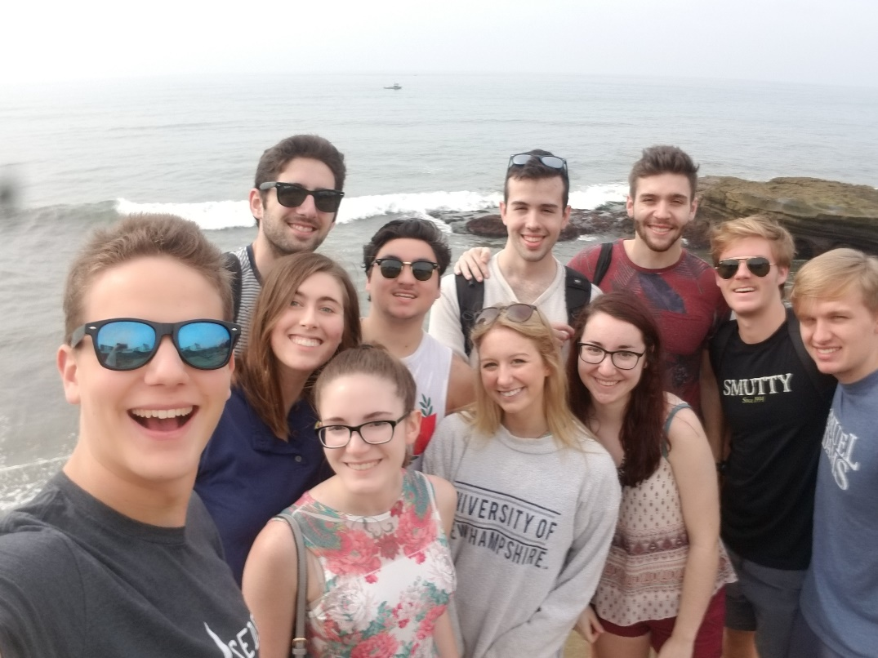
University of New Hampshire
Students for the Exploration and Development of Space

Slide 5
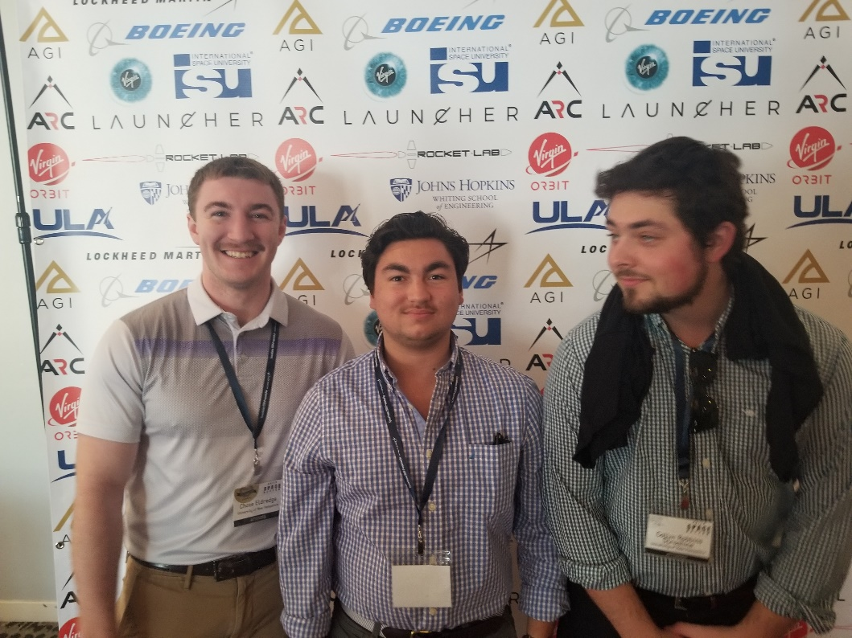
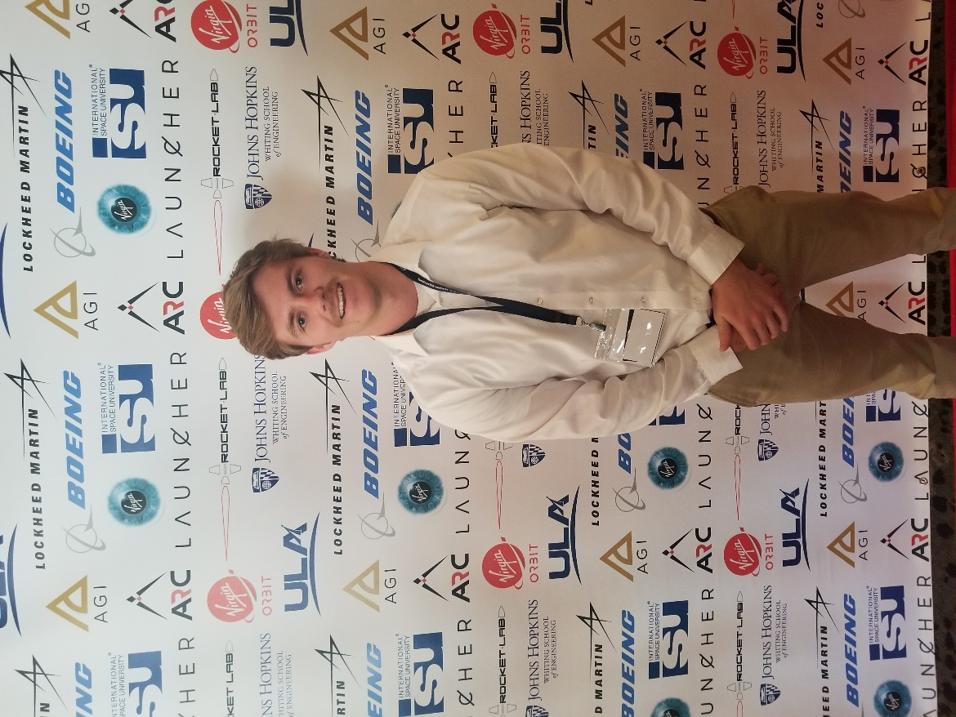
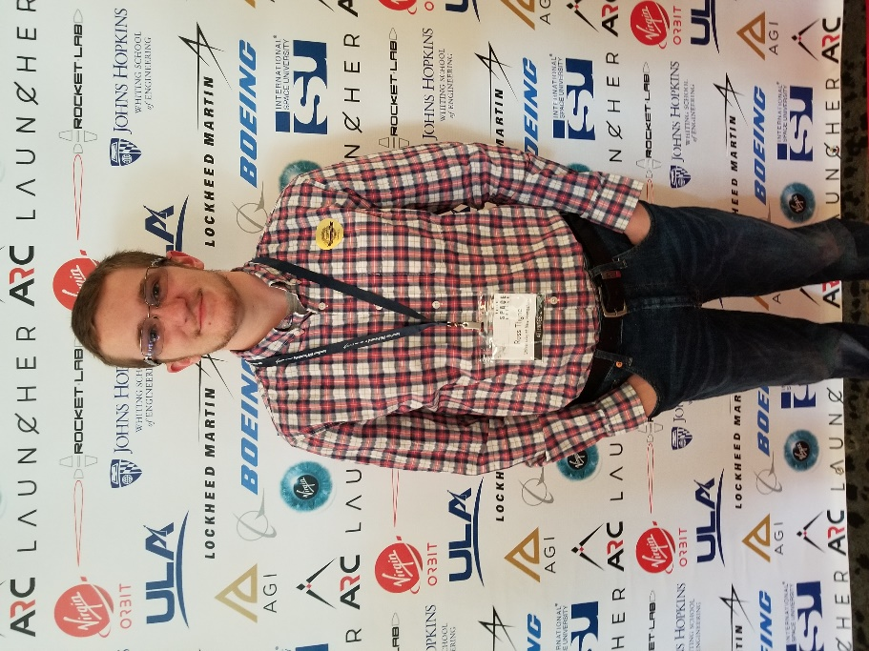
University of New Hampshire
Students for the Exploration and Development of Space

